Slide 1
AWSDev DynamoDB

Slide 2


DynamoDB
Fast and flexible NoSQL DB
Single digit millisecond latency at any scale
Fully managed, you only create tables
Supports key:value and document data models
Backed by SSDs
Spread across 3 geographically distinct regions
Choice of:
Eventual consistent reads (default) – is consistent across all copies within 1 sec
Strongly consistent reads – is consistent across all copies

Slide 3
Features
Tables
Items – Row
Attributes – Column
Key-value and document data structures supported
Key = name of data, value = data itself
Document formats: JSON, HTML, XML

Slide 4

Keys
Primary keys
Partition key – determines partition in which physical data is stored
Composite key – partition key + sort key
For e.g. User in a blogging site posting comments - userid + comment_timestamp
2 items may have same partition key but must have different sort keys

Slide 5

Access control
Managed by IAM
User can be given access to create, update , delete tables
Role can be assumed for temporary access
IAM Condition to give access to their own records

Slide 6
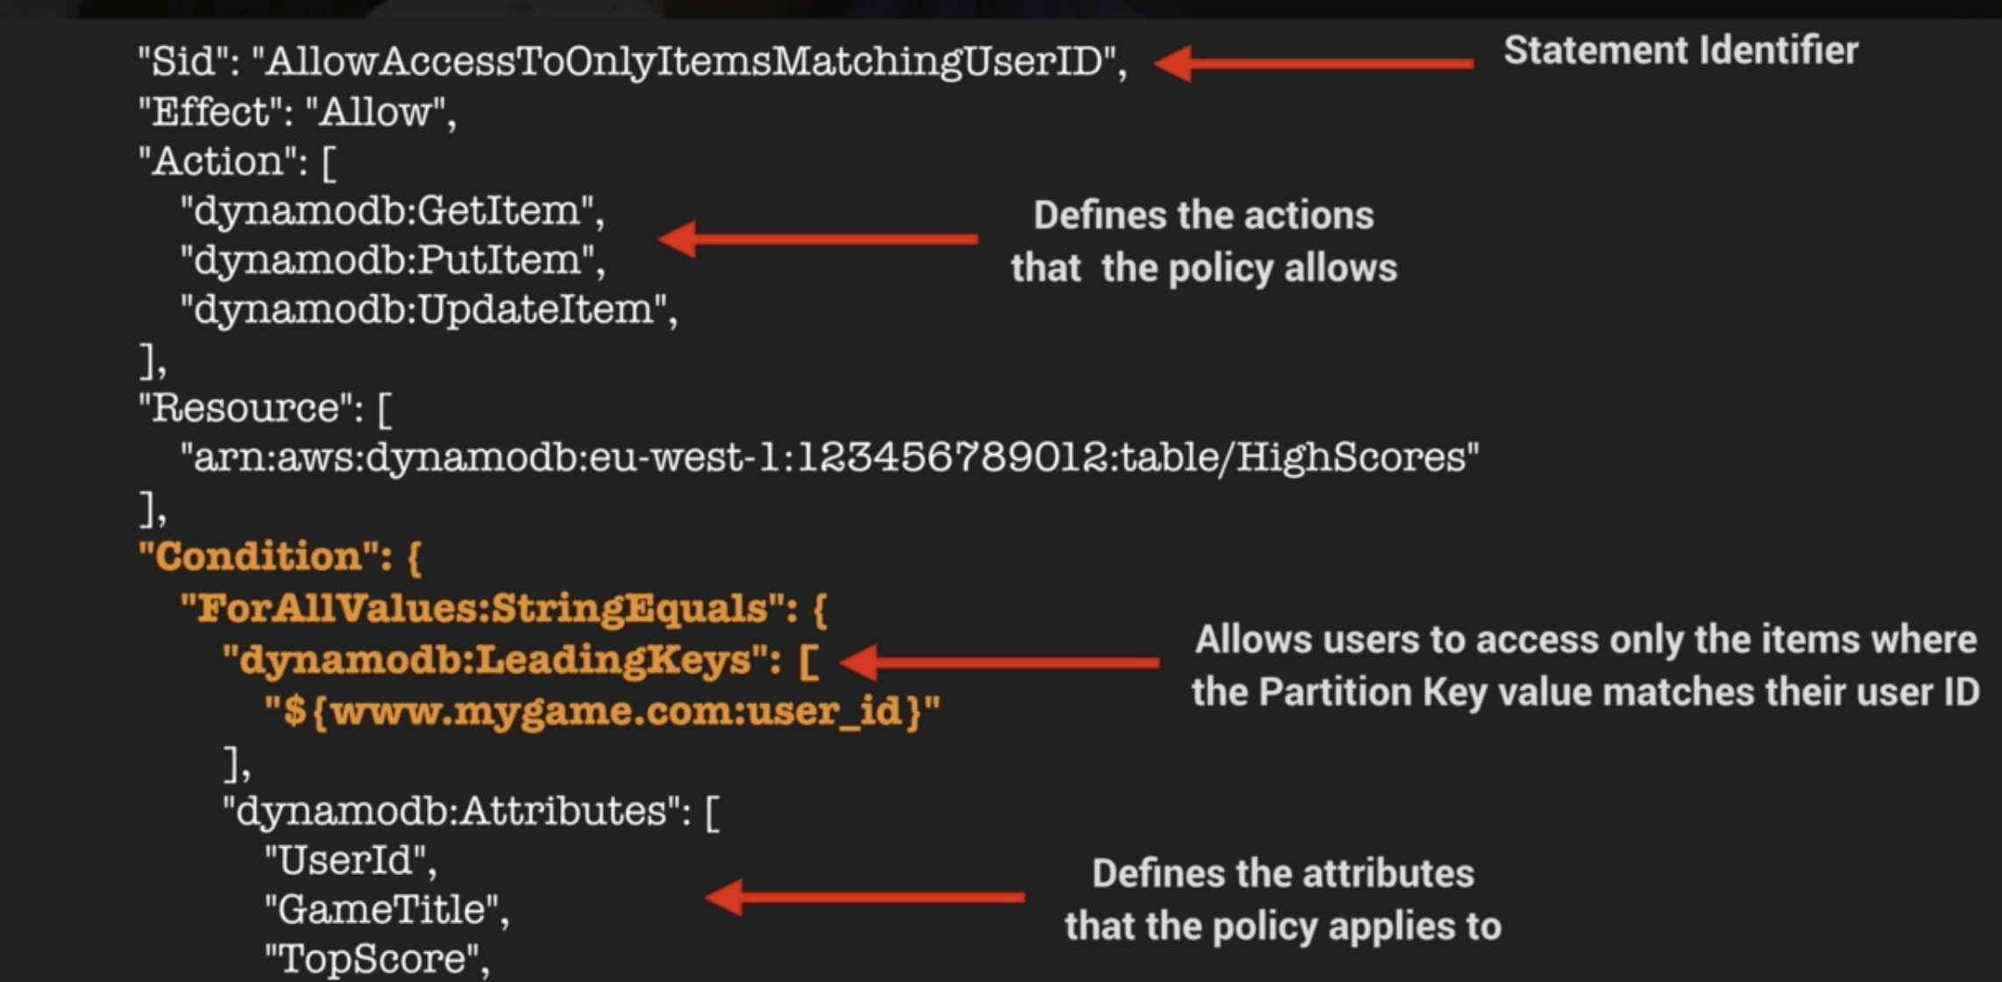
IAM Condition example DynamoDB:LeadingKeys

Slide 7
On Demand
Scales automatically, no need to specify requirements
Pay for what you use
Charges apply for: Reading, writing, storing
Use this for unknown, unpredictable traffic, spiky, short lived
Other wise: Provisioned

Slide 8
DynamoDB Accelerator (DAX)
Fully managed, clustered in-memory cache
Delivers 10x read performance
Microsecond performance for millions of requests/sec
Ideal for read heavy / bursty workloads
Auction, gaming or retail

Slide 9
Features
Write through caching – stored in cache and back end at same time
Allows you to point DYnamoDB API calls to DAX cache
On cache hit, DAX returns data
On cache miss, DAX performs eventually consistent getItem call to DynamoDB
Reduces read load from DynamoDB
May save cost by reducing provisioned capacity

Slide 10

Not suitable for
Strongly consistent read requirements
Write intensive
Apps that do not perform a lot of reads, and do no require microsecond responses

Slide 11
Elasticache
In memory cache in cloud
Improves performance – no need to retrieve from disk
Good for taking load of DB
Good if DB is read heavy and data is not changing much

Slide 12
Benefits and use cases
Read heavy workloads – for e.g. social media, gaming
Can be used to store I/O and compute intensive workloads
2 types:
Memcached
Widely adopted memory object caching
Multi-threaded
No Multi AZ support
Redis
Opensource in-memory key-value store
Supports more complex data structures
Multi AZ support (use case for high availability, cannot lose data)

Slide 13

Caching strategies
Lazy loading – only loads cache if when necessary, not every time
Pros: cache is not filled with useless data, node failures are not fatal
Cons: cache misses penalty, stale data
Write through – writes to cache every time
Pros: never stale data, users more tolerant in updating data than reading
Cons: Write penalty, wasted resources if most data never read from cache

Slide 14
DAX vs Elasticache
Generally speaking, DAX is the one to use for DynamoDB and Elasticache is the one to use for RDS

Slide 15
TTL
Expiry time for cached data
Reduces cost
Expressed in epoch time, unix time
When TTL expires, item is marked for deletion, and it is actually deleted within 48 hours

Slide 16
Streams
Time ordered sequence recorded as a log
Stored for 24 hours
Used for auditing, trigger events based on
Logs change in table
Logs encrypted at rest
Dedicated endpoint for access
Primary key is recorded by default
Before and after images captured
Can be used as event source for lambda

Slide 17

Exceptions
Provisionedthroughputexceededexception
Request rate higher than provisioned capacity
SDK will auto retry
If not using SDK:
Reduce request frequency
use exponential backoff – progressively longer wait intervals

Slide 18
More stuff
Querying – GET/PUT for user-defined primary key
Scans are less efficient – reduce page size, isolate scan operations
Global tables – for distributed users across regions

